Slide 1
Towards Semantically Grounded Decision Rules Using ORM⁺
Presenter: Yan Tang (Belgium)
Authors: Yan Tang, Peter Sypns and Robert Meersman
RuleML 2007 (Florida, USA)

Slide 2
Summary
Background: Ontologies and semantically grounded decision rules
ORM approach to ontological commitments and its problems
The solution: ORM⁺
Discussion
Conclusion
Future Work

Slide 3
Background
Why semantically grounded decision rules?
  Decision support systems mainly contain non-sharable decision rules
    Decision rules are rarely written in an agreed, formal way
  Difficult to check the redundancy and similarity in the decision rule set
    E.g. if (weather is bad) then (stay at home)
    else if( weather is good) then (go for a walk).
    if not (it’s sunny) then (stay at home)
    else if (it’s sunny) then (go for a walk).
Use ontology to store the conceptual definition and decision items
  E.g. “bad weather”
Ontology
  Explicit, sharable, formal, conceptual, stored in computers
  DOGMA (Developing Ontology-Grounded Methods and Applications) Approach to ontology:
    Double articulation: ontology = lexon base+ commitment (R. Meersman, 1999)

Slide 4
Double articulation principle of ontology engineering
Lexon (conceptualization):
  Lexon: plausible binary fact
  E.g. <γ, driver, has, is issued to, drivers license>; < γ, driving experience, is of, has, driver>
Commitment (axiomatization):
  Describes particular application views of reality
    the use of lexons
  Provides multiple views on stored lexons
  Needs to be expressed by commitment language

Slide 5

ORM approach to commitment and its problems
ORM
  Object Role Modeling, Terry Halpin, 1990’s
  Intended for modeling and querying DB at a conceptual level
  Why ORM?
    Semantically rich modeling language to model and visualize commitments for non-technical domain experts
      Expressive capabilities in its graphical notation
      Verbalization possibilities
    ORM-ML for machines
      Store ORM graphs
      Can be mapped to OWL
  Problems
    ORM still lacks several logical operators and connectors for the decision semantics, e.g. implication
    Difficulties to specify some logical operators, e.g. negation

Slide 6
The solution: ORM⁺
ORM⁺ : an extension of ORM
  Basic propositional logic connectives
    Negation
    Conjunction
    Disjunction
    Implication
  Modality operators
    Necessity
    Possibility
  Process operator
    Sequence

Slide 7
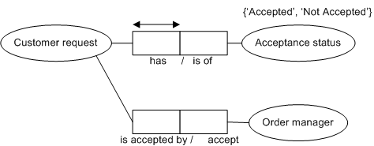
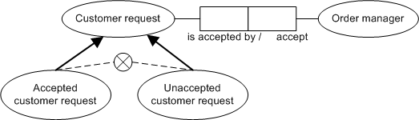
ORM⁺ Approach to Commitments – Negation
ORM: “closed-world” assumption1) use value type; 2)use exclusion constraint
ORM⁺: “open-world” assumption
  because machine needs to know whether the negative situation is taken or not

Slide 8

ORM⁺ Negation Graph & Markup Language
<Predicate id="lexon-2">
<Object_Role ID=“lexon2_forward" Object="CustomerRequest" Role="isAcceptedBy"/>
<Object_Role ID=“lexon2_backward" Object="OrderManager" Role="Accept"/>
</Predicate>
…
<Neg>
<Atom>
<Predicate>
<Object_Role>lexon2_forward</Object_Role>
</Predicate>
</Atom>
<Atom>
<Predicate>
<Object_Role>lexon2_backward</Object_Role>
</Predicate>
</Atom>
</Neg>
ORM ML+ RuleML

Slide 9
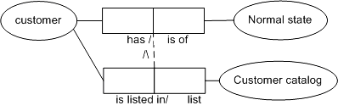
ORM⁺ Approach to Commitments – Conjunction
ORM: doesn’t exist
ORM⁺
    …
    <Predicate id="lexon-3">
    <Object_Role ID=“lexon3_forward" Object="Customer" Role="has"/>
    <Object_Role ID=“lexon3_backward" Object="NormalState" Role="isOf"/>
    </Predicate>
    <Predicate id="lexon-4">
    <Object_Role ID=“lexon4_forward" Object="Customer" Role="isListedIn"/>
    <Object_Role ID=“lexon4_backward" Object="CustomerCatalog" Role="list"/>
    </Predicate>
    …
    <And>
    <Atom>
    <Predicate>lexon-3</Predicate>
    </Atom>
    <Atom>
    <Predicate>lexon-4</Predicate>
    </Atom>
    </And>
    …

Slide 10
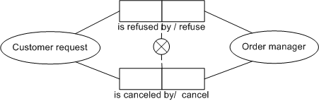
ORM⁺ Approach to Commitments – Disjunction
ORM:
  exclusive-or constraint
  without (ordinary or)
ORM⁺:
  reuse the exclusive constraint
    <constraint type=“exclusive-or”>
    <Object_Role>lexon-5</Object_Role>
    <Object_Role>lexon-6</Object_Role>
    </constraint>
  Ordinary or
    <Or>
    <Atom>
    <Predicate>lexon-5</Predicate>
    </Atom>
    <Atom>
    <Predicate>lexon-6</Predicate>
    </Atom>
    </Or>
  …

Slide 11
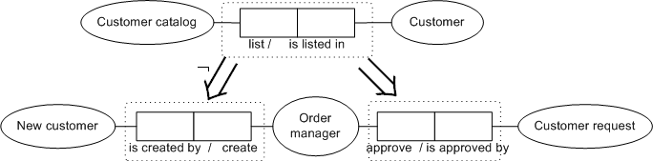
ORM⁺ Approach to Commitments – Implication
ORM: doesn’t exist
ORM⁺:
  <Rule type="Implies">
  <head>
  <Atom>
  <Predicate>lexon-7</Predicate>
  </Atom>
  </head>
  <body>
  <Neg>
  <Atom><Predicate><Object_Role>lexon8-forward</Object_Role></Predicate></Atom>
  <Atom><Predicate><Object_Role>lexon8-backward</Object_Role></Predicate></Atom>
  </Neg>
  </body>
  </Rule>
  <Rule type="Implies">
  <head>
  <Atom><Predicate>lexon-9</Predicate></Atom>
  </head>
  <body>
  <Atom><Predicate>lexon-8</Predicate></Atom>
  </body>
  </Rule>…

Slide 12

ORM⁺ Approach to Commitments – Necessity
ORM: verbalization only (ORM2)
ORM⁺:
  …
  <Predicate id="lexon-9">
  <Object_Role ID=“lexon9_forward" Object="Customer" Role="isListedIn"/>
  <Object_Role ID=“lexon9_backward" Object="CustomerCatalog" Role="list"/>
  </Predicate>
  …
  <Constraint xsi:type= “Necessity”>
  <Object_Role>
  lexon9_forward
  </Object_Role>
  <Object_Role>
  lexon9_backward
  </Object_Role>
  </Constraint>
  …

Slide 13

ORM⁺ Approach to Commitments – Possibility
ORM: verbalization only (ORM2)
ORM⁺:
  …
  <Predicate id="lexon-10">
  <Object_Role ID=“lexon10_forward" Object="Customer" Role="has"/>
  <Object_Role ID=“lexon10_backward" Object="NormalState" Role="isOf"/>
  </Predicate>
  …
  <Constraint xsi:type= “Possibility”>
  <Object_Role>
  lexon10_forward
  </Object_Role>
  <Object_Role>
  lexon10_backward
  </Object_Role>
  </Constraint>
  …

Slide 14
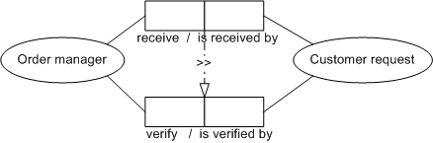
ORM⁺ Approach to Commitments – Sequence
ORM: doesn’t exist
ORM⁺: used to control the process flow
  …
  <Rule xsi:type="Sequence" direction="forward">
  <Atom>
  <Predicate>lexon-11</Predicate>
  </Atom>
  <Atom>
  <Predicate>lexon-12</Predicate>
  </Atom>
  </Rule>
  …

Slide 15
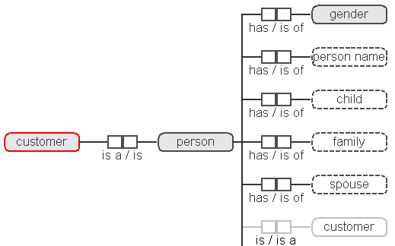
Semantically rich decision rules (example)
Concepts are defined in domain ontologies
Decision items need to be annotated with domain ontologies
  Tools: T-Lex, SDT plugin @ STARlab

Slide 16
Conclusion
Conclusion
  ORM⁺ is to model, visualize, store and share semantically rich decision rules
  ORM⁺ extends ORM graphical notations
  ORM⁺ ML = ORM ML + RuleML + others
    ORM⁺ ML schema reuses 31 type definitions from ORM ML schema, 10 type definitions from FOL Rule-ML and introduces 7 new type definitions
    Can be used by different rule engines
      InfoSapient
      JLisa
      OpenRules
      OpenLexicon
      Etc.

Slide 17
Discussion and Future Work
Discussion:
  More symbols, more difficult to verbalize the commitments
  Complexity
Future work:
  Mapping ORM⁺ ML to one inference engine
  ORM⁺ visualization tool

Slide 18
Questions?
Thank you!

